Slide 1
  Memory Hierarchy in Multicore Systems: Cache Design (L1, L2, L3), Cache Coherence, Memory Bandwidth and Latency
Presented by : Tank Awasthi

Slide 2
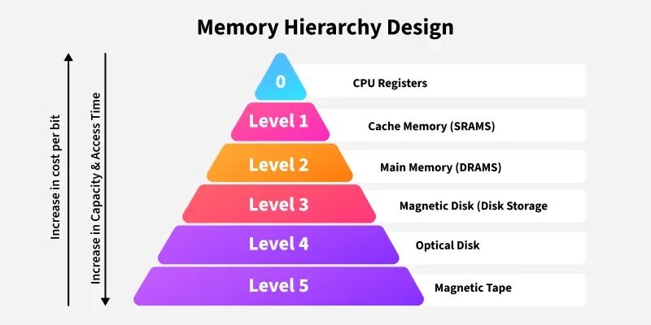
Memory Hierarchy Design is divided into 2 main types.
External Memory or Secondary Memory(Magnetic Disk, Optical Disk, and Magnetic Tape)peripheral storage devices.
Internal Memory or Primary Memory(Main Memory, Cache Memory & CPU registers). This is directly accessible by the processor.

Slide 3
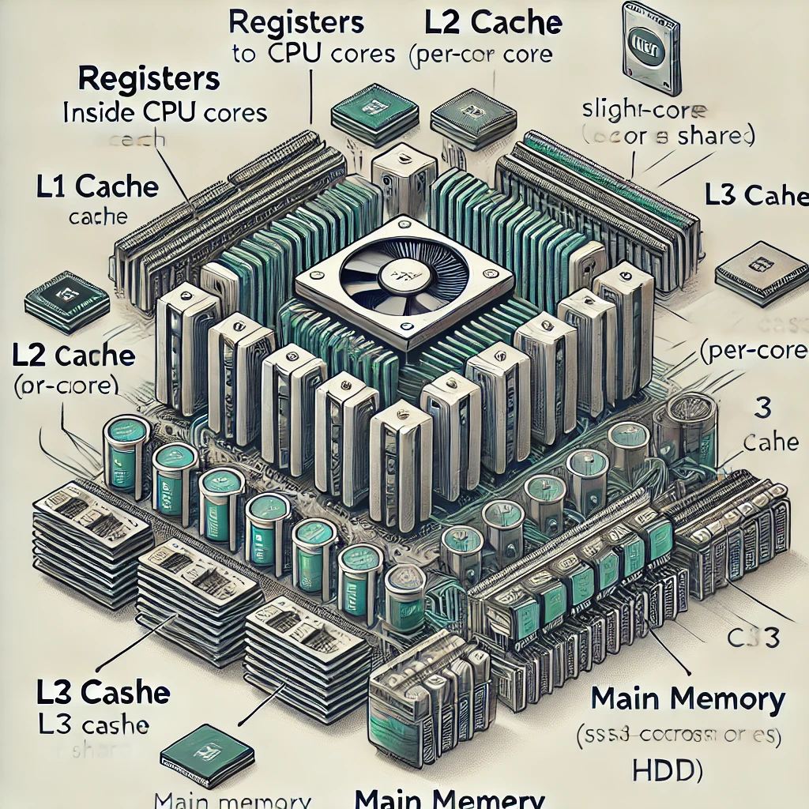
store the most frequently used data and instructions
Size:16-64 Bits
Stores frequently used data and instructions that have been recently accessed from the main memory
Cache Size
Block Size
Mapping Function
Replacement Algorithm
Write policy
store data and instructions that are currently in use by the CPU
store data and instructions that are not currently in use by the CPU.

Slide 4
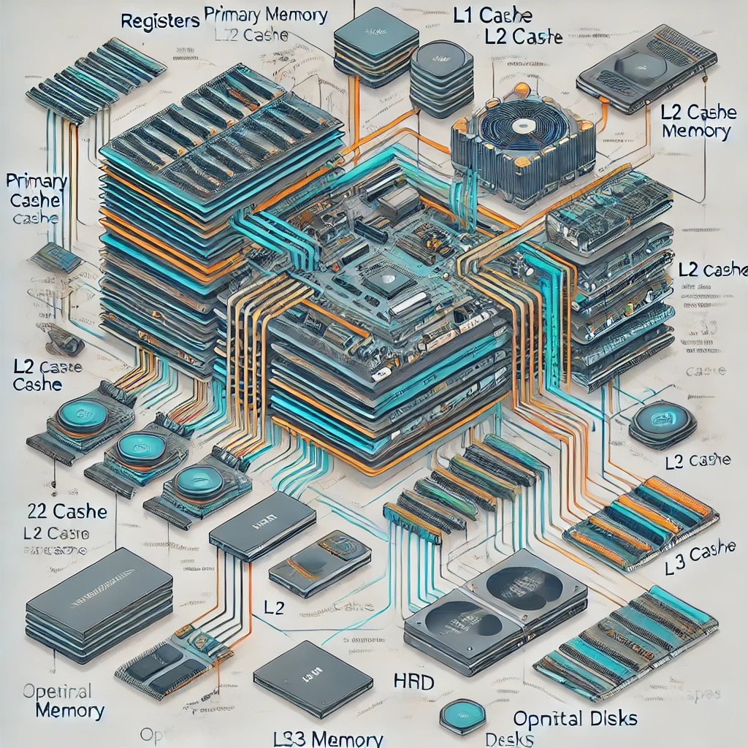
Complex Design
Cost Per Bit
Latency
Performance
Access Time
Capacity
Maintenance Overhead

Slide 5
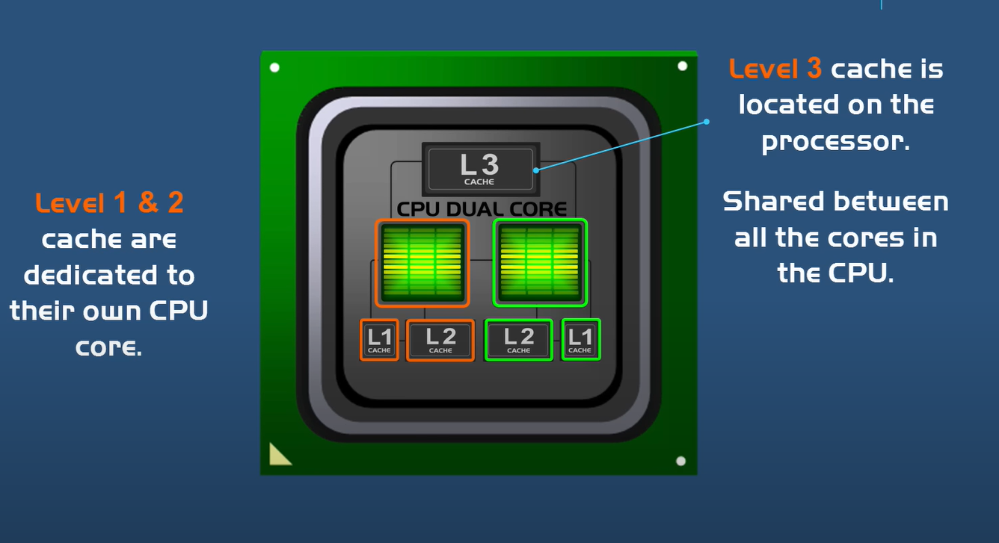

Slide 6
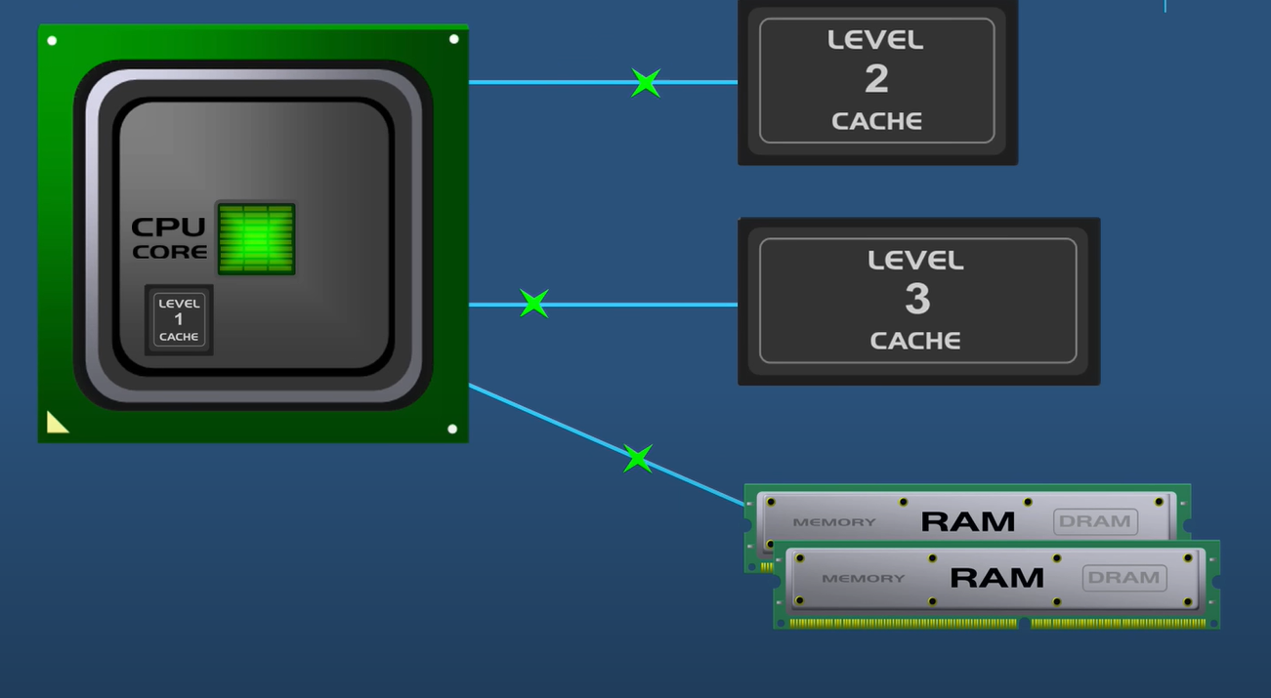

Slide 7
L1 Cache
  Smallest
  Fastest
  Storing the most frequently accessed data & instructions for immediate use by the CPU core.
L2 Cache
  Slightly slower than L1
  Larger than L1
  Serving as a backup to L1
  holding data that’s not used as frequently.
L3 Cache
  Largest and slowest
  Shared among all CPU cores.
  Helping coordinate data sharing across cores and improving performance in multi-core CPUs.

Slide 8
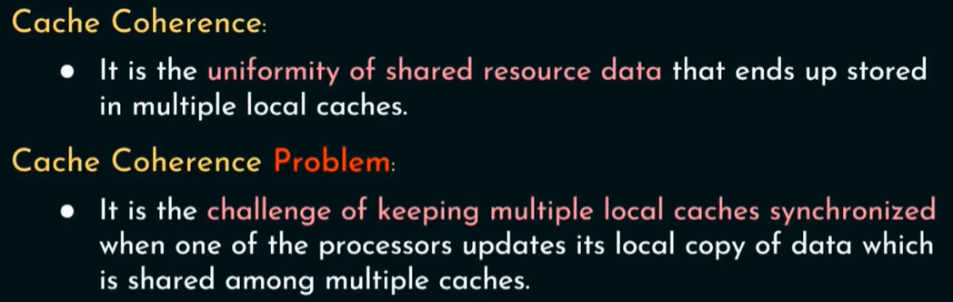
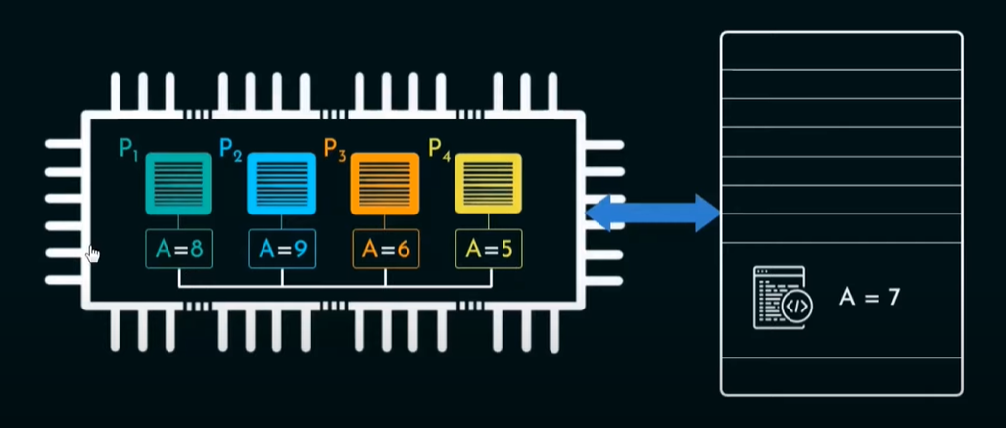

Slide 9
Cache Bandwidth
Amount of data that can be transferred from cache to the CPU in a given amount of time. It is typically measured in gigabytes per second (GB/s) or megabytes per second (MB/s).
Factors Influencing Cache Bandwidth
  Cache Width
  Clock Speed
  Cache Organization
  Number of Cores
  L1 cache can have high bandwidth (up to 100+ GB/s in modern processors).
  L2 cache is generally lower than L1, but still very fast (typically in the range of 10–30 GB/s).
  L3 has a lower bandwidth compared to L1 and L2, usually ranging from 10–25 GB/s in modern processors

Slide 10
Latency
Latency is the time it takes for the cache to retrieve the requested data from the cache line(cache hit) or to determine that the data is not in the cache(cache miss).
Factors Influencing Cache Latency
  Level of Cache
  Cache Size
  Cache Organization
    L1 Cache: Access time is typically 1-2 CPU cycles.
    L2 Cache: Access time is typically 3-10 CPU cycles.
    L3 Cache: Access time is typically 10-20 CPU cycles.

